Slide 1


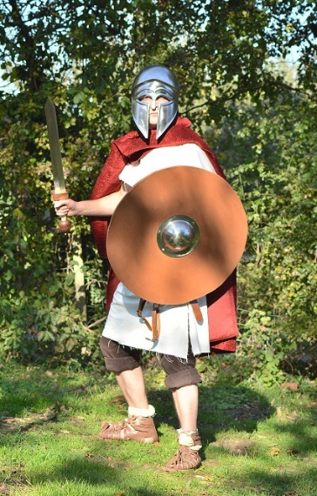
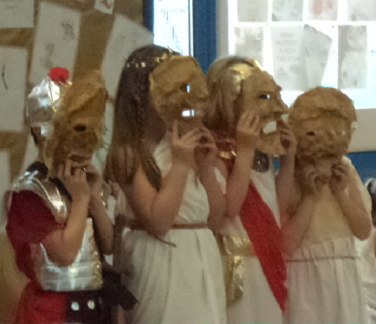
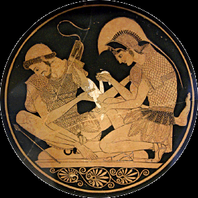
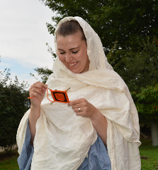
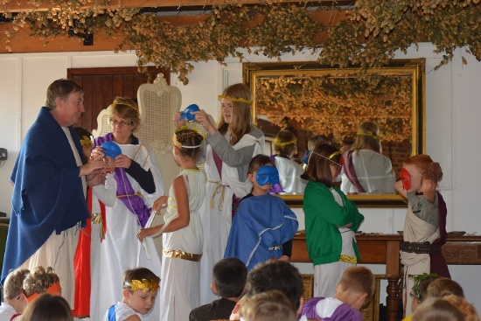

Greek Day
Wednesday 19th October 2016
Home Life
Arachne’s Web
Theatre with Aristophanes
From Magic to Medicine
Gods & Heroes
Greeks Warriors
Price per child only £9!
Free!
Adults*
Risk Assessments
Lunchroom
Parking
For more information or to book your class, please contact the Education Officers on 07519 102272 or email kentlifefarmpark@gmail.com
*1:4 at KS1,
1:5 at KS2

